Slide 1
Classifying Emotion from Tweets using Naïve Bayes
Alex Litchfield

Slide 2
AGENDA
Project Definition/Scope
Approach Taken
Data Used
Results
Conclusion

Slide 3
Project Definition/Scope
Dataset
Hypothesis
Model
Features
The dataset is a collection of annotated english twitter messages. Each message has an emotion label attached: sadness, joy, love, anger, fear, and surprise. It has over 400,000 entries.
Using the contents of a tweet, the primary emotion being conveyed by the user can be predicted
Naïve Bayes
Unigrams, bigrams, TF-IDF
Notes:
Unigrams (single word), bigram (word pairs) and TF-IDF (statistic reflecting the importance of a word in a dataset relative to a corpus)
https://www.kaggle.com/datasets/nelgiriyewithana/emotions

Slide 4
Dataset Example
Text | Label
i just feel really helpless and heavy hearted | 4
i feel so stupid that i realise it so late | 0
i miss all the others as well that feel that i wronged them and they will soon understand that i didnt | 3
i didn t feel terrific | 1
Label In actual Dataset | 0 | 1 | 2 | 3 | 4 | 5
Emotion | Sadness | Joy | Love | Anger | Fear | Surprise
Notes:
The top table shows some actual entries in the dataset. The bottom table shows what emotion each label correlates to.

Slide 5
Approach Taken
Data Preprocessing
Software Used
Minimal preprocessing needed; Removed entries with missing information
Pandas and numpy for data organization
Sklearn and imblearn for the model and metrics
K-Fold Cross Validation
Oversampling
Data is divided into k=5 equal size folds. The model is trained and tested k times, validating through different portions each time
Some emotions are more frequent than others in the dataset, with surprise trailing behind the next least frequent by over 5,000 occurrences.
Notes:
Data Preprocessing: The dataset only had 2 columns, so little no preprocessing was needed
Oversampling: Oversampling was performed to try and even out the number of labels in the data

Slide 6
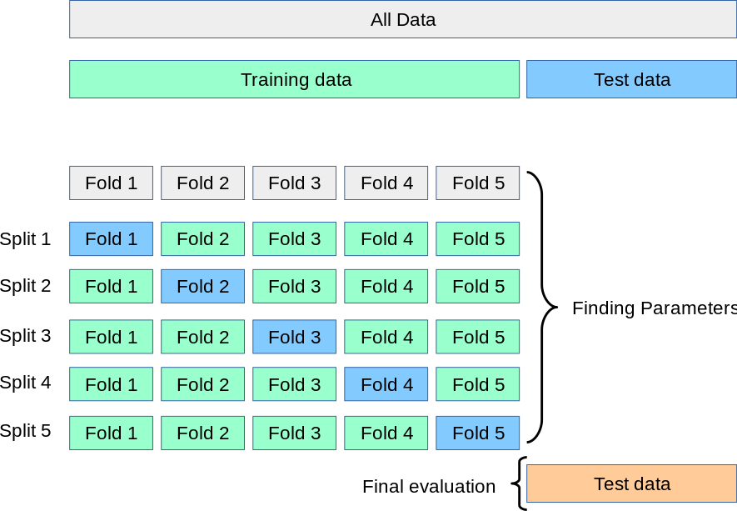
Notes:
https://scikit-learn.org/stable/_images/grid_search_cross_validation.png
Grey boxes are what fold we are currently on in the loop, the blue boxes are the fold being used as test data in the current iteration, and the green boxes are the training data for the current iteration. Finds different data combinations as you create more folds. Tradeoff for better results is complexity in the model and time it takes to run.

Slide 7
Implementation and Data Used
Loop through K-Folds (K=5)
Split data
Perform Stopword Removal
Tokenization/TF-IDF
OverSampling (If used)
Fit data to classifier/Predict
Notes:
Loop through K folds (K = 5)
(Note: Each step after is performed in the loop for the given k fold)
Split the data into training/testing sets as previously shown. To ensure duplicate combos didn’t occur, the test data would be the data from the current fold, and all other data would be the test data
Stopword removal is the removal of common words that don’t help the model and are just clutter. Examples are the words “is”, “and” or “the”.
Tokenization breaks down the text into tokens, where TF-IDF uses this to store how important/frequent the word is in the corpus. Tokens are created based on unigrams and bigrams, and the max vocabulary size for the model is 5000. Under 5000 results in lower metrics, meaning the model needs more info to work with, and over 5000 results in slightly lowered metrics and an increased overhead time, likely due to irrelevant words being tracked that otherwise wouldn’t be.
Over Sampling addresses the imbalance in the emotion labels and balances the distribution better. Two versions of the model exist, one with and one without oversampling to show its impact on the matter
The data is fit to the classifier so that it can perform a prediction on the given k-fold
Metrics are taken on each k-fold and stored

Slide 8
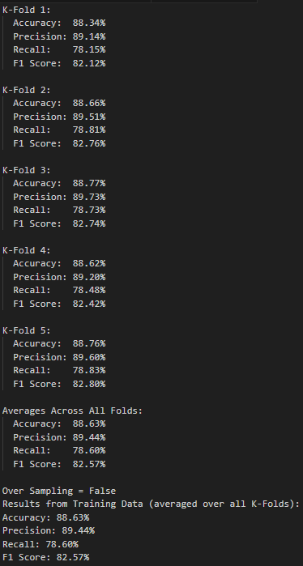
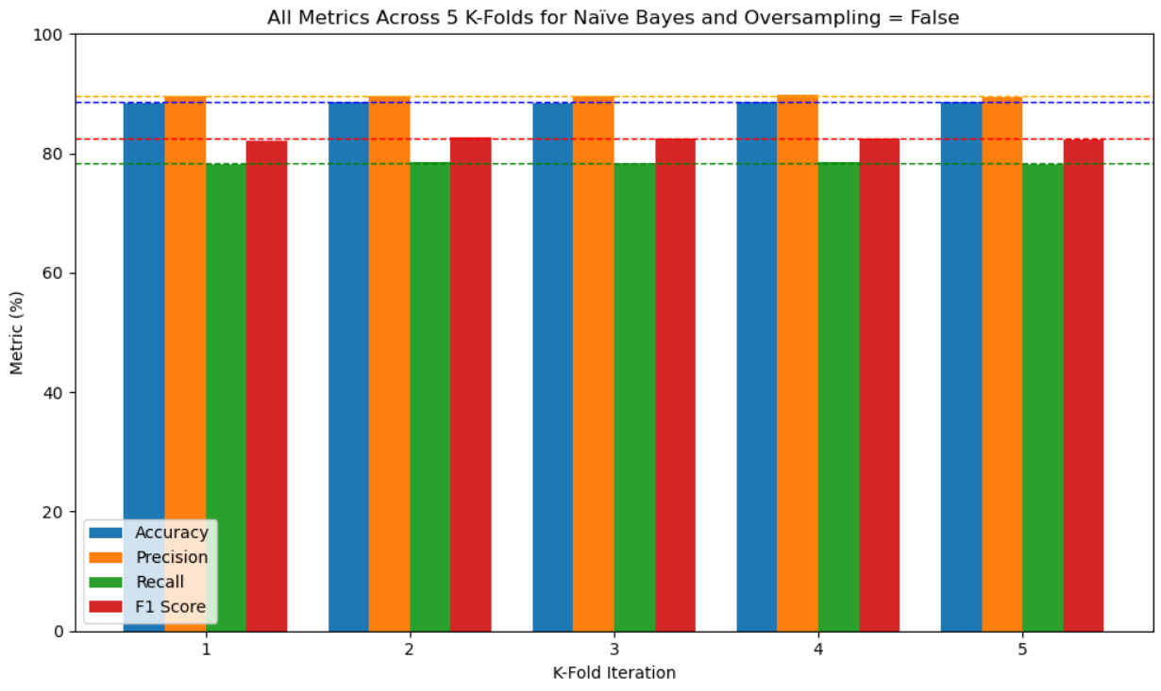
Results - (No OS)
Notes:
Metrics tracked: Accuracy, Precision, Recall, and F1 Score

Slide 9
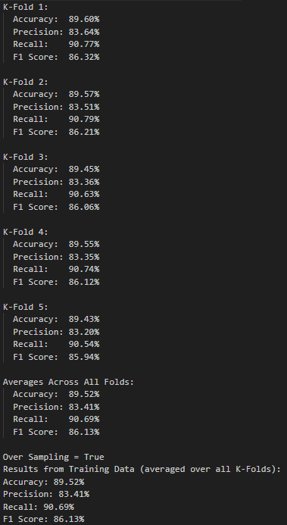
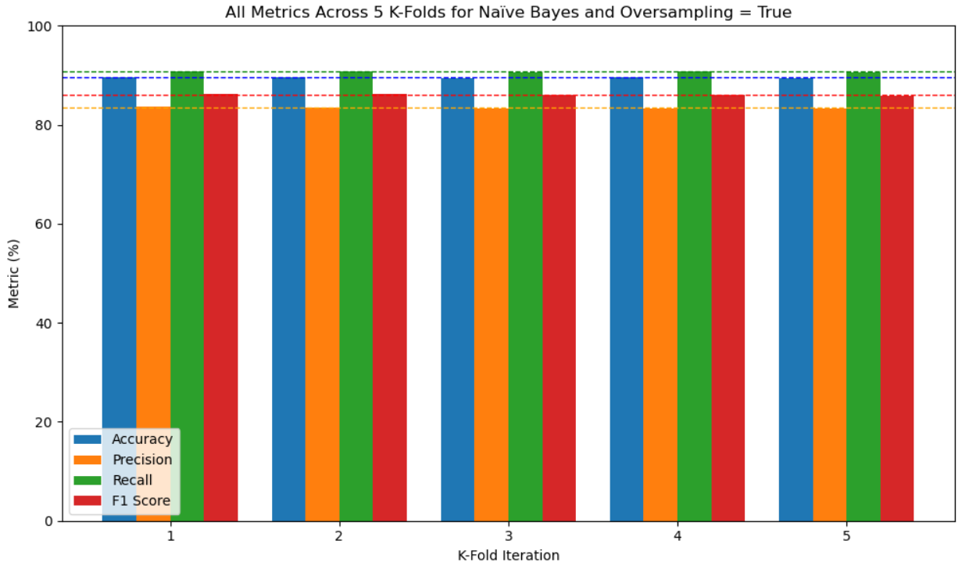
Results - (OS)

Slide 10
Results Comparison
+
Conclusion
Average for the metric across all K-folds | Over Sampling = False | Over Sampling = True
Accuracy (%): | 88.55% | 89.52%
Precision (%): | 89.58% | 83.41%
Recall (%): | 78.36% | 90.69%
F1 Score (%): | 82.41% | 86.13%
Notes:
Accuracy: Tells us how many of the model’s predictions were correct overall across all classes
Precision: Tells us how often the model is correct when it predicts a class (how trustworthy is the prediction for the given class?).
Recall: The number of True Positives (TP) over the number of True Positives (TP) and False Negatives (FN) -> TP / (TP + FN). A true positive is an instance where the class was correctly classified by the model. A false negative is an instance where a class should have been guessed but the model ruled that class out as an option (aka picked another)
F1 Score: The harmonic mean between precision and recall. A score that shows the balance between the 2 other scores.
All scores improved when over sampling was performed except for precision, which took a slight hit. However, given that 3/4 metrics improved INCLUDING F1 score, this outcome overall made the model perform better. F1 Score is an extremely important metric because it not only reflects both precision and recall, but the balance between the 2 as well.
Overall, the model performed well. It could be improved through a variety of ways, such as introducing other ways of feature extraction or manually setting aside a test/train split (this is NOT what k-fold cross validation does, so it would be a different method altogether). The hypothesis of whether or not we could predict the primary emotion conveyed in a tweet was proven to be true!

Slide 11
References
https://www.kaggle.com/datasets/nelgiriyewithana/emotions
https://scikit-learn.org/stable/_images/grid_search_cross_validation.png
https://numpy.org/doc/
https://pandas.pydata.org/docs/
https://scikit-learn.org/stable/modules/naive_bayes.html
https://scikit-learn.org/stable/modules/feature_extraction.html
https://scikit-learn.org/stable/modules/generated/sklearn.model_selection.KFold.html#sklearn.model_selection.KFold
https://imbalanced-learn.org/stable/over_sampling.html
https://scikit-learn.org/stable/modules/model_evaluation.html

